Slide 1
LSTM reduction of a Gas Turbine for Real-Time simulation
Ioannis Myrsinias
12/09/2023

Slide 2
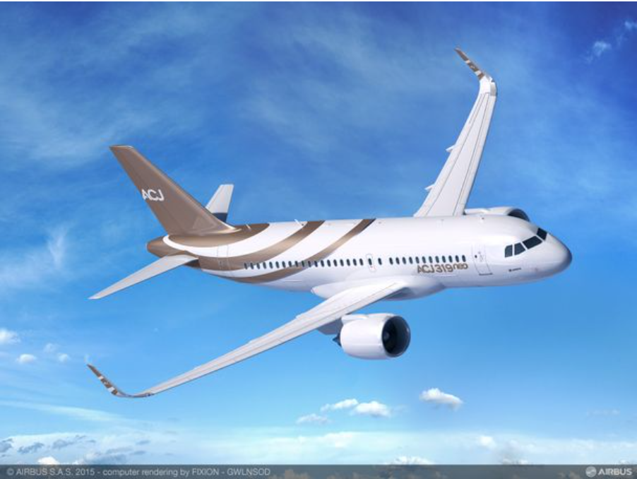
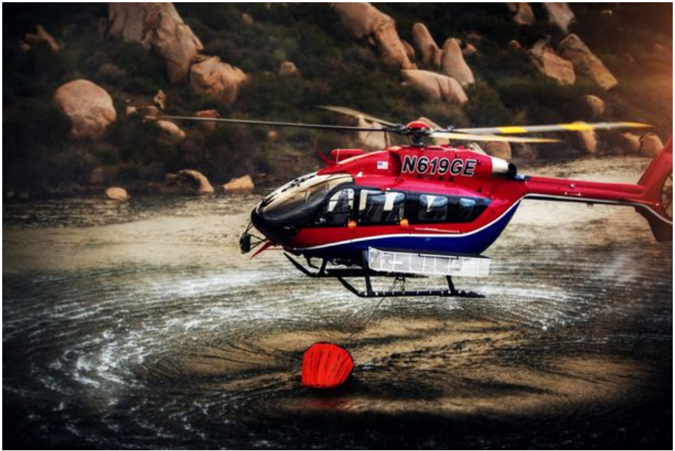
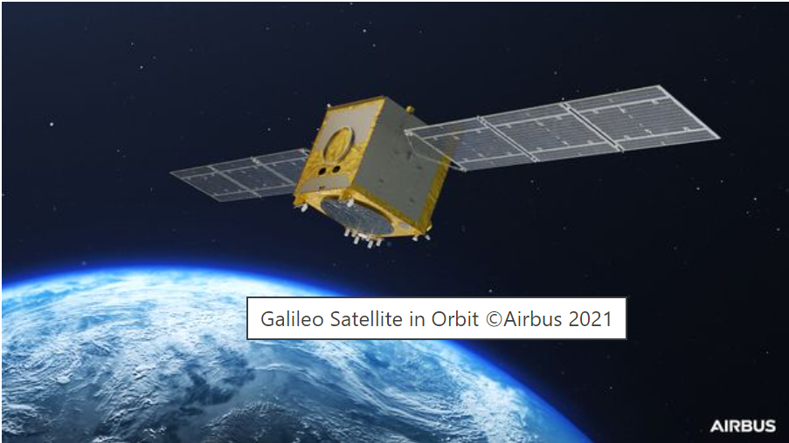
AIRBUS
Connect
Serve
Explore
Notes:
29% of aerospace industry

Slide 3

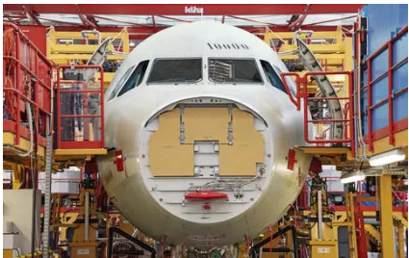
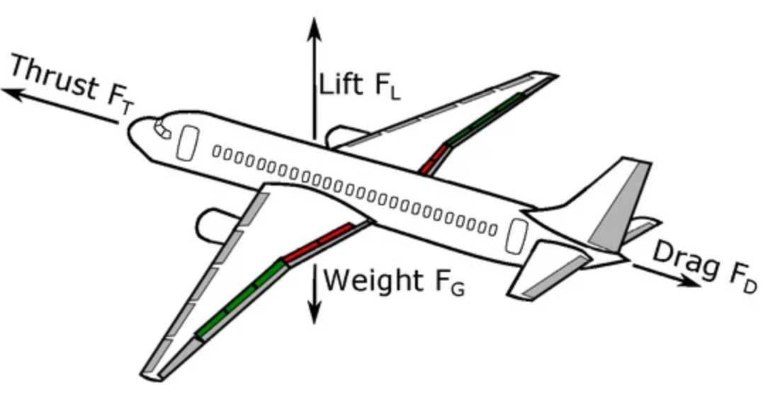
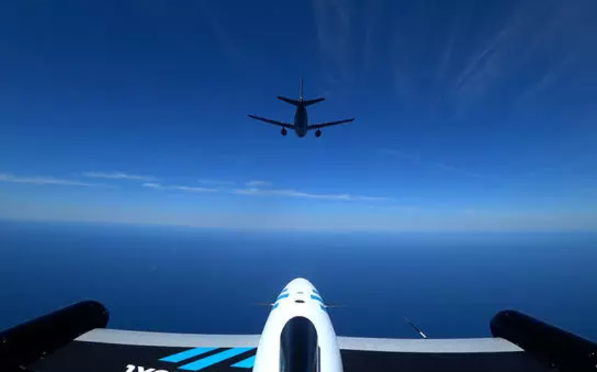
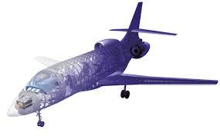
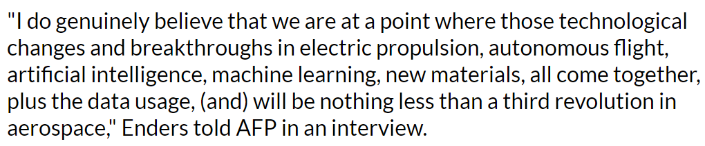
AIRBUS invests in Artificial Intelligence
2017
2018-2023
Could we accelerate prototyping and predictive maintenance?
Skywise platform
AI in manufacturing
AIRBUS CEO
Auto refuel
Data driven techniques
Notes:
https://www.aviationbusinessnews.com/low-cost/artificial-intelligence-aviation-industry/

Slide 4
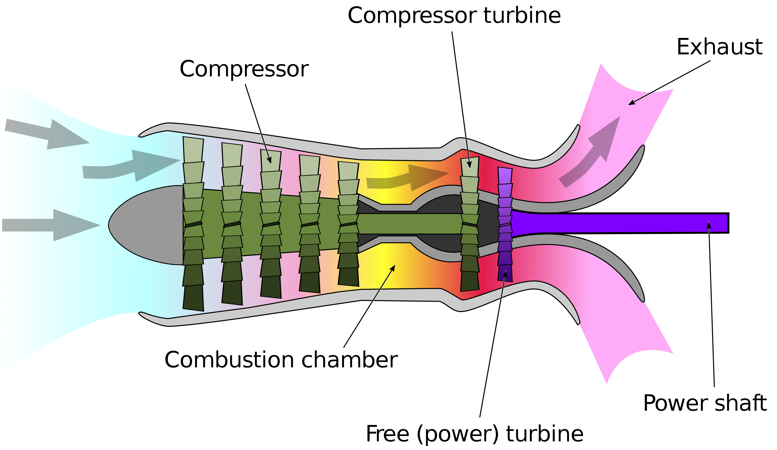

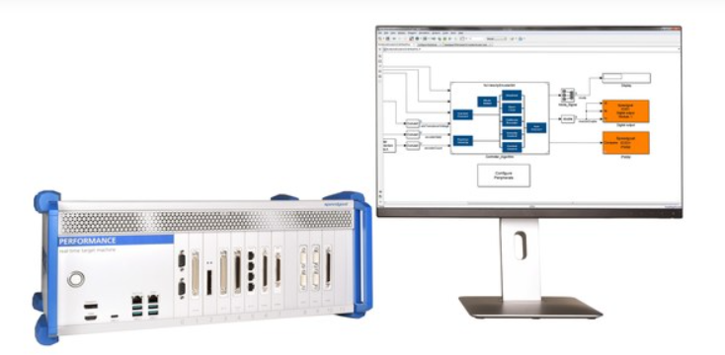

Model Reduction for Hardware in the Loop
How?
Model a physical system
Develop a Reduced Order Model
Emulate the real-time response
Prepare hardware-in-the-loop (HIL) testing
Model
Test
Advantages
Learn from the experience
Reduce the computational cost
Accelerate systems design
Test the control systems before real hardware deployment
Reduce
Deploy

Slide 5
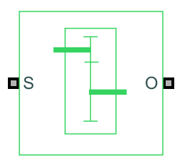
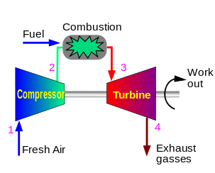
Turboshaft Engine – Physical model
MECHANICAL
SPECIFICATIONS
Simscape Driveline
Simplify
Parametrize
THERMODYNAMICS
Simscape Fluids

Slide 6
Turboshaft Engine - Reduced Order Model
Input
Height
Heat in the burner
Output
Gas turbine RPM
Free pressure turbine RPM
Mechanical power
Air mass flow
Pressure after the compressor
Temperature after the burner
Network layers
…

Slide 7
Demonstration – Reduced order model with LSTM network
A flow chart supporting the workflow
Physical model of Turboshaft Engine
Generate data
Preprocess data
Train an LSTM neural network
Evaluate the model
Deploy the model on Speedgoat

Slide 8
Demonstration – Reduced order model with LSTM network
Some pictures/animations from the different steps to show the customer what we showed them
Physical model of Turboshaft Engine
Generate data
Preprocess data
Train an LSTM neural network
Evaluate the model
Deploy the model on Speedgoat

Slide 9
Conclusion
Possible to learn from the experience
LSTM networks are sensitive to data quality
Increase model performance
Accurate response
Areas of attention
Data drifting
Long timeseries
OOD : out of distribution data

Slide 10
Thank you for your attention! Do you have any questions?
Notes:
What are this project’s goals

Slide 11
DRAFT
Notes:
What are this project’s goals

Slide 12
Contents
Introduction – AIRBUS invests in AI
Model reduction for Hardware in the loop
Turboshaft Engine in Simulink
Reduced Order Model
Demonstration – Reduced order model with LSTM network
Conclusion

Slide 13
Lessons learned
Not straightforward approach

Slide 14
Prepare the engagement with the customer
How our tools can be connected to each other
Explore workflow for rapid prototyping with LSTM ROM

Slide 15
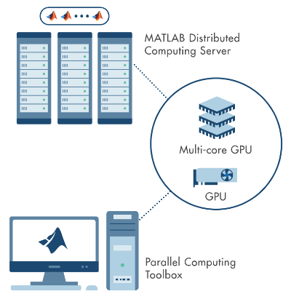


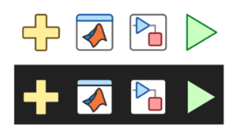


Image Resources
Technical and Workflow Diagram Toolkit
Create simple or complex technical diagrams using provided elements. Each component is an individual artifact for use in presentation materials or video assets.
Illustration Style
Get illustrations in categories including Avatars, Personas, Technology, Transportation, Sports, and more. Find the complete set alongside some rules and recommendations.
Icon Repository
Icon ID Catalog (theme-able)
Find toolstrip, block, plot, and other in-product icons.
V23.0 Delete this slide before finalizing your presentation.

Slide 16
PowerPoint Resources
Corporate PowerPoint Template FAQ and Resources
This page provides resources, tips, and best practices for updating existing presentations as well as how to get started if you are creating a new presentation.
Presentation Guidelines
These guidelines explain how to keep your presentation visually up-to-date, when to use the confidential and nonconfidential templates, how to design visually compelling slides, and other best practices.
Highspot Sales Content System
Highspot (license required) is the centralized, up-to-date source for customer-facing slides and presentations, including release and product-related presentations as well as user story and technical article summary slides.
V23.0 Delete this slide before finalizing your presentation.
Questions concerning presentation design?
Contact Bernice Cheng, bernicec@mathworks.com

Slide 17
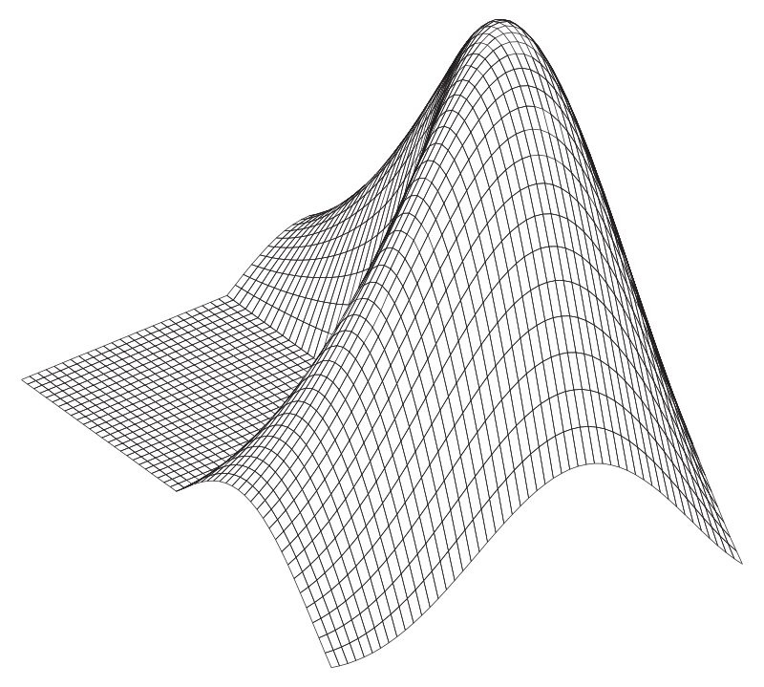
Image Resources
MathWorks Design System (Parula)
Learn how to create content that better represents the MathWorks brand and access MathWorks logos and release and service marks.
Best Practices for Finding Images and Stock Photos
Get guidelines for using the MathWorks Asset Library (with over 30k images), stock photography, illustrations, clip art, and more.
V23.0 Delete this slide before finalizing your presentation.

Slide 18
Color Palette
MathWorks Brand Colors
The corporate colors are included in the Theme Colors of this PowerPoint file; the primary brand colors and HEX values are shown below. For more colors such as utility and neutral colors, visit the brand guide Color Palette.
MATLAB Code Colors
Below are the color values for MATLAB code. They are not included in this file’s default Color Themes due to limited colors, but you can either enter the values below or use the Eyedropper or Format Painter to copy and apply them.
PRIMARY COLORS
REGULAR CODE
HEX: 000000
RGB: 0, 0, 0
KEYWORD
HEX: 0000ff
RGB: 0, 0, 255
HEX: 0076A8
HEX: D78825
STRING
HEX: A020F6
RGB: 160, 32, 240
COMMENT
HEX: 228B22
RGB: 34, 139, 34
SECONDARY COLOR
WARNING
HEX: FF6400
RGB: 255, 100, 0
ERROR
HEX: FF0000
RGB: 255, 0, 0
HEX: 004B87
V23.0 Delete this slide before finalizing your presentation.

